Slide 1


COMPUTER ORGANIZATION AND ARCHITECTURE
MODULE 2

Slide 2
MODULE 2
Microarchitecture - Introduction; Performance analysis; Single-Cycle Processor - Single Cycle Datapath, Single Cycle Control; Pipelined Processor - Pipelined Data Path, Pipelined Control: Hazards, Solving Data/Control Hazards, Performance Analysis.

Slide 3

Microarchitecture -
Introduction;
Performance analysis;

Slide 4
Introduction: Architectural State and Instruction Set : 415
A computer architecture is defined by its instruction set and architectural state.
The architectural state for the RISC-V processor consists of the program counter and the 32 32-bit registers.
Any RISC-V microarchitecture must contain all of this state.
Based on the current architectural state, the processor executes a particular instruction with a particular set of data to produce a new architectural state.

Slide 5
To keep the microarchitectures easy to understand, we focus on a
subset of the RISC-V instruction set.
▸ R-type instructions: add, sub, and, or, slt
▸ Memory instructions: lw, sw
▸ Branches: beq

Slide 6
Introduction: Design Process: 416
We divide microarchitectures into two interacting parts:
  the datapath
  and the control unit.
The datapath operates on words of data. It contains structures such as memories, registers, ALUs, and multiplexers. [a datapath is the core set of hardware components within a CPU that process and move data] We are implementing the 32-bit RISC-V (RV32I) architecture, so we use a 32-bit datapath.
The control unit receives the current instruction from the datapath and tells the datapath how to execute that instruction. Specifically, the control unit produces multiplexer select, register enable, and memory write signals to control the operation of the datapath.

Slide 7
A good way to design a complex system is to start with hardware containing the state elements.
These elements include the memories and the architectural state (the program counter and registers).
Then, add blocks of combinational logic between the state elements to compute the new state based on the current state.
The instruction is read from part of memory; load and store instructions then read or write data from another part of memory.
Hence, it is often convenient to partition the overall memory into two smaller memories, one containing instructions and the other containing data.

Slide 8
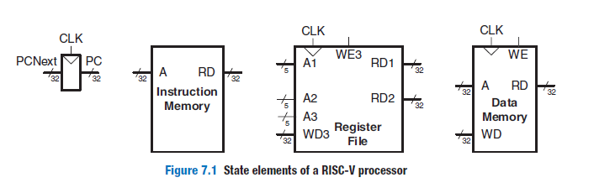
Figure 7.1 shows a block diagram with the four state elements: the program counter, register file, and instruction and data memories.

Slide 9
Heavy lines indicate 32-bit data busses.
Medium lines indicate narrower busses, such as the 5-bit address busses on the register file.
Narrow lines indicate 1-bit wires, and blue lines are used for control signals, such as the register file write enable.

Slide 10
The program counter (PC) points to the current instruction.
Its input, PCNext, indicates the address of the next instruction.
The instruction memory has a single read port.
It takes a 32-bit instruction address input, A, and reads the 32-bit data (i.e., instruction) from that address onto the read data output, RD.
The 32-element × 32-bit register file holds registers x0–x31.
The register file has two read ports and one write port.
The read ports take 5-bit address inputs, A1 and A2, each specifying one of the 2⁵ = 32 registers as source operands.

Slide 11
The register file places the 32-bit register values onto read data outputs RD1 and RD2.
The write port, port 3, takes a 5-bit address input, A3; a 32-bit write data input, WD3; a write enable input, WE3; and a clock.
If its write enable (WE3) is asserted, then the register file writes the data (WD3) into the specified register (A3) on the rising edge of the clock.

Slide 12
The data memory has a single read/write port.
If its write enable, WE, is asserted, then it writes data WD into address A on the rising edge of the clock.
If its write enable is 0, then it reads from address A onto the read data bus, RD.

Slide 13
The instruction memory, register file, and data memory are all read combinationally.
In other words, if the address changes, then the new data appears at RD after some propagation delay; no clock is involved.
The clock controls writing only.
These memories are written only on the rising edge of the clock.

Slide 14
Introduction: Microarchitectures: 418
Three microarchitectures for the RISC-V architecture:
    single-cycle,
    multicycle, and
    pipelined.
The single-cycle microarchitecture executes an entire instruction in one cycle.
The multicycle microarchitecture executes instructions in a series of shorter cycles.
The pipelined microarchitecture applies pipelining to the single-cycle microarchitecture. It therefore can execute several instructions simultaneously, improving the throughput significantly. Simpler instructions execute in fewer cycles than complicated ones.

Slide 15
PERFORMANCE ANALYSIS
The cost of a particular processor architecture depends on the amount of hardware required and the implementation technology
There are many ways to measure the performance of a computer system.
The computer that executes your program fastest has the highest performance.
The next best choice is to measure the total execution time of a collection of programs that are similar to those you plan to run.
Such collections of programs are called benchmarks, and the execution times of these programs are commonly published to give some indication of how a processor performs.

Slide 16
Dhrystone, CoreMark, and SPEC are three popular benchmarks.
The first two are synthetic benchmarks composed of important common pieces of programs.
Both benchmarks are less than 16 KB in size and do not stress the instruction cache.
The SPECspeed 2017 Integer benchmark from the Standard Performance Evaluation Corporation (SPEC) is composed of real programs.
The benchmark is widely used for high-performance processors because it stresses the entire system in a representative way.

Slide 17
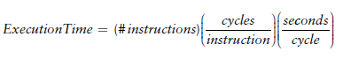
PERFORMANCE ANALYSIS
The cost of a particular processor architecture depends on the amount of hardware required and the implementation technology
There are many ways to measure the performance of a computer system.
The computer that executes your program fastest has the highest performance.

Slide 18
The number of instructions in a program depends on the processor architecture.
The number of instructions also depends enormously on the cleverness of the programmer.
The cycles per instruction (CPI) is the number of clock cycles required to execute an average instruction.
It is the reciprocal of the throughput (instructions per cycle, or IPC).
Different microarchitectures have different CPIs.
The number of seconds per cycle is the clock period, Tc.
The clock period is determined by the critical path through the logic in the processor.
Different microarchitectures have different clock periods.

Slide 19
Single-Cycle Processor -
Single Cycle Data path,
Single Cycle Control;

Slide 20
SINGLE-CYCLE PROCESSOR: 420
A microarchitecture that executes instructions in a single Cycle is called a Single cycle processor.
We begin constructing the datapath by connecting the state elements from Figure 7.1 with combinational logic that can execute the various instructions.
Control signals determine which specific instruction is performed by the datapath at any given time.
The control unit contains combinational logic that generates the appropriate control signals based on the current instruction

Slide 21
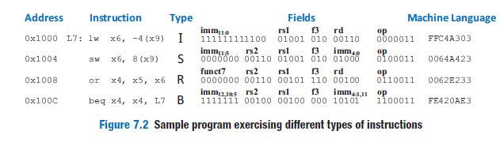
SINGLE-CYCLE PROCESSOR: Sample Program

Slide 22
SINGLE-CYCLE PROCESSOR: Sample Program
Suppose that the program is stored in memory starting at address 0x1000.
The figure indicates the address of each instruction, the instruction type, the instruction fields, and the hexadecimal machine language code for the instruction.
Assume that register x5 initially contains the value 6 and x9 contains 0x2004.
Memory location 0x2000 contains the value 10.
The program counter begins at 0x1000.

Slide 23
SINGLE-CYCLE PROCESSOR: Sample Program
The lw reads 10 from address (0x2004 – 4) = 0x2000 and puts it in x6.
The sw writes 10 to address (0x2004 + 8) = 0x200C.
The or computes x4 = 6 | 10 = 0110₂ | 1010₂ = 1110₂ = 14.
Then, beq goes back to label L7, so the program repeats forever.

Slide 24
SINGLE-CYCLE PROCESSOR: Single-Cycle Datapath: 421
This section gradually develops the single-cycle datapath, adding one
piece at a time to the state elements from Figure 7.1.
The new connections are emphasized in black (or blue, for new control signals), whereas the hardware that has already been studied is shown in gray.
The example instruction being executed is shown at the bottom of each figure.

Slide 25
SINGLE-CYCLE PROCESSOR: Single-Cycle Datapath: 421
The program counter contains the address of the instruction to execute.
The first step is to read this instruction from instruction memory.
Figure 7.3 shows that the PC is simply connected to the address input of the instruction memory.
The instruction memory reads out, or fetches, the 32-bit instruction, labeled Instr.
In our sample program from Figure 7.2, PC is 0x1000. (Note that this is a 32-bit processor, so PC is really 0x00001000, but we omit leading zeros to avoid cluttering the figure.)

Slide 26
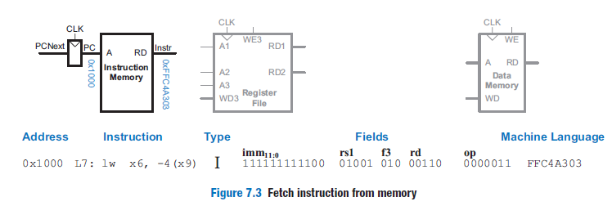
SINGLE-CYCLE PROCESSOR: Single-Cycle Datapath: 421
lw : load word instruction

Slide 27
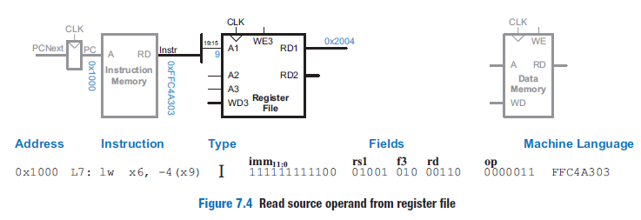
SINGLE-CYCLE PROCESSOR: Single-Cycle Datapath: 421
lw : load word instruction

Slide 28
SINGLE-CYCLE PROCESSOR: Single-Cycle Datapath
lw : load word instruction
For the lw instruction, the next step is to read the source register containing the base address.
lw is an I-type instruction, and the base register is specified in the rs1 field of the instruction, Instr_{19:15}.
These bits of the instruction connect to the A1 address input of the register file, as shown in Figure 7.4.
The register file reads the register value onto RD1.
In our example, the register file reads 0x2004 from x9.

Slide 29
SINGLE-CYCLE PROCESSOR: Single-Cycle Datapath
lw : load word instruction
The lw instruction also requires an offset.
The offset is stored in the 12-bit immediate field of the instruction, Instr_{31:20}.
It is a signed value, so it must be sign-extended to 32 bits.
Sign extension simply means copying the sign bit into the most significant bits: ImmExt_{31:12} = Instr₃₁ , and ImmExt_{11:0} = Instr_{31:20}.
Sign-extension is performed by an Extend unit, as shown in Figure 7.5, which receives the 12-bit signed immediate in Instr_{31:20} and produces the 32-bit sign-extended immediate, ImmExt.
In our example, the two’s complement immediate −4 is extended from its 12-bit representation 0xFFC to a 32-bit representation 0xFFFFFFFC.

Slide 30
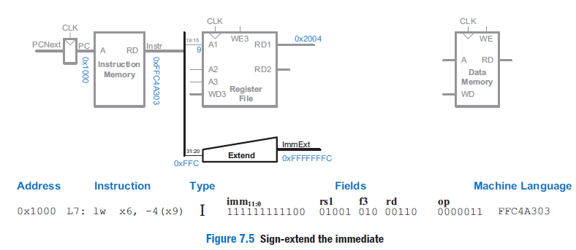
SINGLE-CYCLE PROCESSOR: Single-Cycle Datapath
lw : load word instruction

Slide 31
SINGLE-CYCLE PROCESSOR: Single-Cycle Datapath
lw : load word instruction
The processor adds the base address to the offset to find the address to read from memory.
Figure 7.6 introduces an ALU to perform this addition.
The ALU receives two operands, SrcA and SrcB.
SrcA is the base address from the register file, and SrcB is the offset from the sign-extended immediate, ImmExt.
The ALU receives 32-bit operands and generates a 32-bit ALUResult.

Slide 32
SINGLE-CYCLE PROCESSOR: Single-Cycle Datapath
lw : load word instruction
For the lw instruction, ALUControl should be set to 000 to perform addition.
ALUResult is sent to the data memory as the address to read, as shown in Figure 7.6.
In our example, the ALU computes 0x2004 + 0xFFFFFFFC = 0x2000.

Slide 33
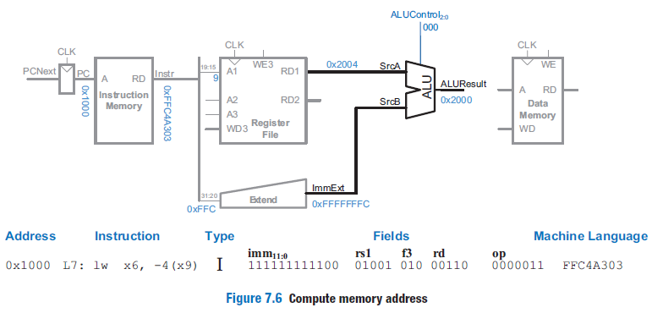
SINGLE-CYCLE PROCESSOR: Single-Cycle Datapath
lw : load word instruction

Slide 34
SINGLE-CYCLE PROCESSOR: Single-Cycle Datapath
lw : load word instruction
This memory address from the ALU is provided to the address (A) port of the data memory.
The data is read from the data memory onto the ReadData bus and then written back to the destination register at the end of the cycle, as shown in Figure 7.7.
Port 3 of the register file is the write port.
lw’s destination register, indicated by the rd field (Instr11:7), is connected to A3, port 3’s address input.

Slide 35
SINGLE-CYCLE PROCESSOR: Single-Cycle Datapath
lw : load word instruction

Slide 36
SINGLE-CYCLE PROCESSOR: Single-Cycle Datapath
lw : load word instruction
The ReadData bus is connected to WD3, port 3’s write data input.
A control signal called RegWrite (register write) is connected to WE3, port 3’s write enable input, and is asserted during the lw instruction so that the data value is written into the register file.
The write takes place on the rising edge of the clock at the end of the cycle.
In our example, the processor reads 10 from address 0x2000 in the data memory and puts that value (10) into x6 in the register file.

Slide 37
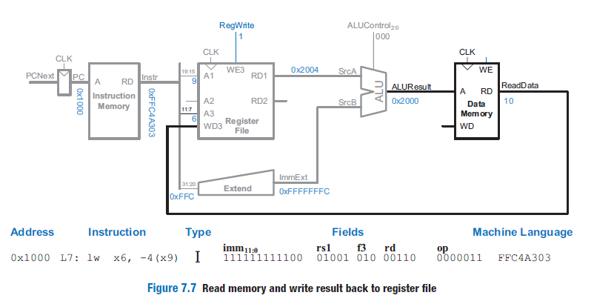
SINGLE-CYCLE PROCESSOR: Single-Cycle Datapath
lw : load word instruction

Slide 38
SINGLE-CYCLE PROCESSOR: Single-Cycle Datapath
lw : load word instruction
While the instruction is being executed, the processor must also compute the address of the next instruction, PCNext.
Because instructions are 32 bits (4 bytes), the next instruction is at PC+4.
Figure 7.8 uses an adder to increment the PC by 4.
In our example, PCNext = 0x1000 + 4 = 0x1004.
The new address is written into the program counter on the next rising edge of the clock.
This completes the datapath for the lw instruction.

Slide 39
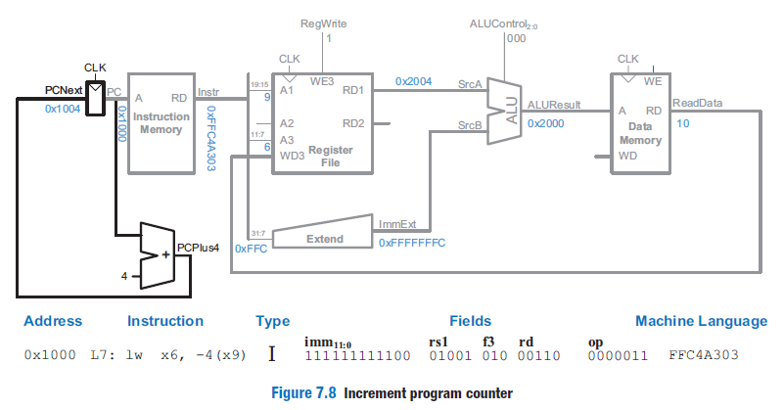
SINGLE-CYCLE PROCESSOR: Single-Cycle Datapath
lw : load word instruction

Slide 40
SINGLE-CYCLE PROCESSOR: Single-Cycle Datapath
sw : store word instruction
sw, which is an S-type instruction.
Like lw, sw reads a base address from port 1 of the register file and sign-extends the immediate.
The ALU adds the base address to the immediate to find the memory address.
All of these functions are already supported in the datapath, but the 12-bit signed immediate is stored in Instr_{31:25,11:7} (instead of Instr_{31:20}, as it was for lw).
Thus, the Extend unit must be modified to also receive these additional bits, Instr_{11:7}.

Slide 41
SINGLE-CYCLE PROCESSOR: Single-Cycle Datapath
sw : store word instruction
For simplicity (and for future instructions such as jal), the Extend unit receives all the bits of Instr_{31:7}.
A control signal, ImmSrc, decides which instruction bits to use as the immediate.
When ImmSrc = 0 (for lw), the Extend unit chooses Instr_{31:20} as the 12-bit signed immediate; when ImmSrc = 1 (for sw), it chooses Instr_{31:25,11:7}.

Slide 42
SINGLE-CYCLE PROCESSOR: Single-Cycle Datapath
sw : store word instruction
The sw instruction also reads a second register from the register file and writes its contents to the data memory.
Figure 7.9 shows the new connections for this added functionality.
The register is specified in the rs2 field, Instr24:20, which is connected to the address 2 (A2) input of the register file.
The register’s contents are read onto the read data 2 (RD2) output, which, in turn, is connected to the write data (WD) input of the data memory.
The write enable port of the data memory, WE, is controlled by MemWrite.

Slide 43
SINGLE-CYCLE PROCESSOR: Single-Cycle Datapath
sw : store word instruction
For an sw instruction: MemWrite = 1 to write the data to memory; ALUControl = 000 to add the base address and offset; and RegWrite = 0, because nothing should be written to the register file.
Note that data is still read from the address given to the data memory, but this ReadData is ignored because RegWrite = 0.

Slide 44
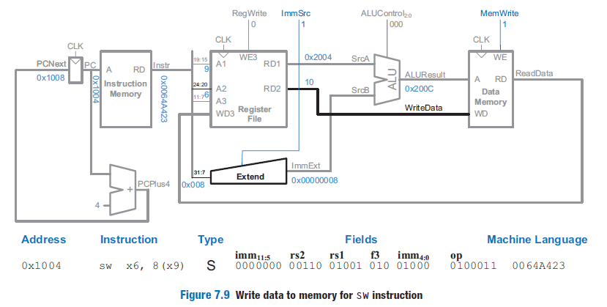
SINGLE-CYCLE PROCESSOR: Single-Cycle Datapath
sw : store word instruction

Slide 45
SINGLE-CYCLE PROCESSOR: Single-Cycle Datapath
sw : store word instruction
In our example, the PC is 0x1004.
Thus, the instruction memory reads out the sw instruction, 0x0064A423.
The register file reads 0x2004 (the base address) from x9 and 10 from x6 while the Extend unit extends the immediate offset 8 from 12 to 32 bits.
The ALU computes 0x2004 + 8 = 0x200C.
The data memory writes 10 to address 0x200C.
Meanwhile, the PC is incremented to 0x1008.

Slide 46
SINGLE-CYCLE PROCESSOR: Single-Cycle Datapath
R-Type Instructions
Next, consider extending the datapath to handle the R-type instructions, add, sub, and, or, and slt(set if less than).
All of these instructions read two source registers from the register file, perform some ALU operation on them, and write the result back to the destination register.
They differ only in the specific ALU operation.
Hence, they can all be handled with the same hardware but with different ALUControl signals.

Slide 47
SINGLE-CYCLE PROCESSOR: Single-Cycle Datapath
R-Type Instructions
Figure 7.10 shows the enhanced datapath handling these R-type instructions.
The datapath reads rs1 and rs2 from ports 1 and 2 of the register file and performs an ALU operation on them.
We introduce a multiplexer and a new select signal, ALUSrc, to select between ImmExt and RD2 as the second ALU source, SrcB.
For lw and sw, ALUSrc is 1 to select ImmExt;
for R-type instructions, ALUSrc is 0 to select the register file output RD2 as SrcB.

Slide 48
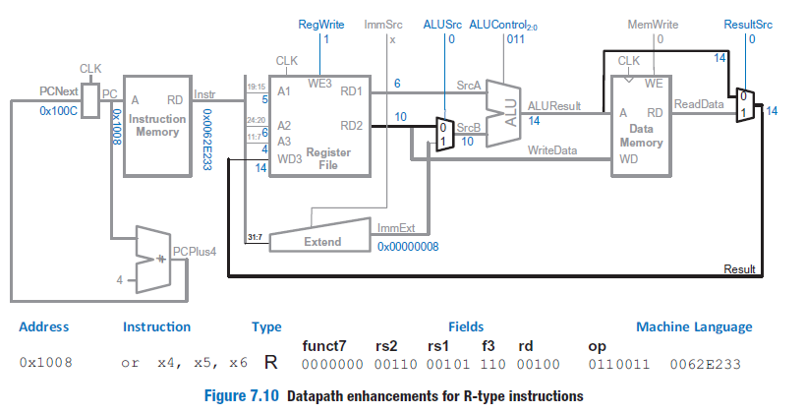
SINGLE-CYCLE PROCESSOR: Single-Cycle Datapath
R-Type Instructions

Slide 49
SINGLE-CYCLE PROCESSOR: Single-Cycle Datapath
R-Type Instructions
Let us name the value to be written back to the register file Result.
For lw, Result comes from the ReadData output of the memory.
However, for R-type instructions, Result comes from the ALUResult output of the ALU.
We add the Result multiplexer to choose the proper Result based on the type of instruction.
The multiplexer select signal ResultSrc is 0 for R-type instructions to choose ALUResult as Result; ResultSrc is 1 for lw to choose ReadData.
We do not care about the value of ResultSrc for sw because it does not write the register file.

Slide 50
SINGLE-CYCLE PROCESSOR: Single-Cycle Datapath
R-Type Instructions
In our example, the PC is 0x1008.
Thus, the instruction memory reads out the or instruction 0x0062E233.
The register file reads source operands 6 from x5 and 10 from x6.
ALUControl is 011, so the ALU computes 6 | 10 = 0110₂ | 1010₂ = 11102 = 14.
The result is written back to x4.
Meanwhile, the PC is incremented to 0x100C.

Slide 51
SINGLE-CYCLE PROCESSOR: Single-Cycle Datapath
beq
Finally, we extend the datapath to handle the branch if equal (beq) instruction.
beq compares two registers.
If they are equal, it takes the branch by adding the branch offset to the program counter (PC).

Slide 52
SINGLE-CYCLE PROCESSOR: Single-Cycle Datapath
beq
The branch offset is a 13-bit signed immediate stored in the 12-bit immediate field of the B-type instruction.
Thus, the Extend logic needs yet another mode to choose the proper immediate.
ImmSrc is increased to 2 bits, using the encoding from Table 7.1.
ImmExt is now either the sign-extended immediate (when ImmSrc = 00 or 01) or the branch offset (when ImmSrc = 10).

Slide 53
SINGLE-CYCLE PROCESSOR: Single-Cycle Datapath
beq
Figure 7.11 shows the modifications to the datapath.
We need another adder to compute the branch target address, PCTarget = PC + ImmExt.
The two source registers are compared by computing (SrcA – SrcB) using the ALU.
If ALUResult is 0, as indicated by the ALU’s Zero flag, the registers are equal.
We add a multiplexer to choose PCNext from either PCPlus4 or PCTarget.

Slide 54
SINGLE-CYCLE PROCESSOR: Single-Cycle Datapath
beq
PCTarget is selected if the instruction is a branch and the Zero flag is asserted.
For beq, ALUControl = 001, so that the ALU performs a subtraction.
ALUSrc = 0 to choose SrcB from the register file.
RegWrite and MemWrite are 0, because a branch does not write to the register file or memory.
We don’t care about the value of ResultSrc, because the register file is not written.

Slide 55
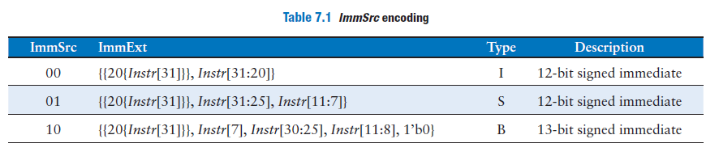
SINGLE-CYCLE PROCESSOR: Single-Cycle Datapath
beq

Slide 56
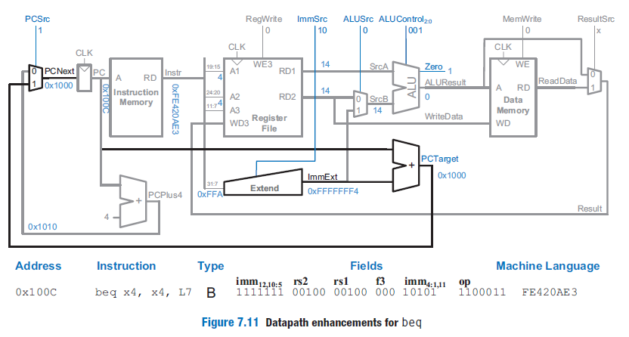
SINGLE-CYCLE PROCESSOR: Single-Cycle Datapath
beq

Slide 57
SINGLE-CYCLE PROCESSOR: Single-Cycle Datapath
In our example, the PC is 0x100C, so the instruction memory reads out the beq instruction 0xFE420AE3.
Both source registers are x4, so the register file reads 14 on both ports.
The ALU computes 14 – 14 = 0, and the Zero flag is asserted. Meanwhile, the Extend unit produces 0xFFFFFFF4 (i.e., −12), which is added to PC to obtain PCTarget = 0x1000.
Note that we show the unswizzled upper 12 bits of the 13-bit immediate on the input of the Extend unit (0xFFA).
The PCNext mux chooses PCTarget as the next PC and branches back to the start of the code at the next clock edge.
This completes the design of the single-cycle processor datapath

Slide 58
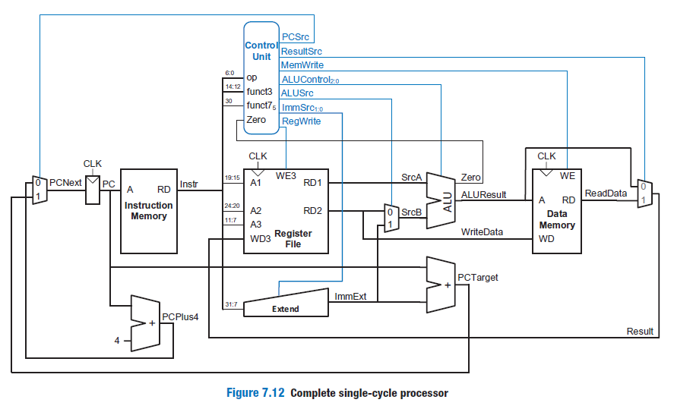
SINGLE-CYCLE PROCESSOR: Single-Cycle Datapath

Slide 59
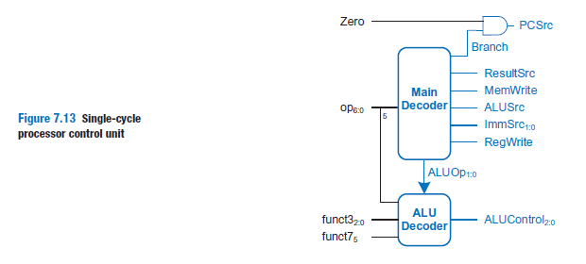
SINGLE-CYCLE PROCESSOR: Single-Cycle Control: 429
The single-cycle processor’s control unit computes the control signals based on op, funct3, and funct7.
Figure 7.12 shows the entire single-cycle processor with the control unit attached to the datapath.

Slide 60
SINGLE-CYCLE PROCESSOR: Single-Cycle Control: 429
Figure 7.13 hierarchically decomposes the control unit, which is also referred to as the controller or the decoder, because it decodes what the instruction should do.
We partition it into two major parts:
  the Main Decoder, which produces most of the control signals, &
  the ALU Decoder, which determines what operation the ALU performs.

Slide 61
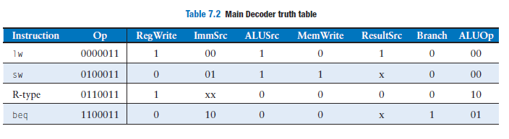
Table 7.2 shows the control signals that the Main Decoder produces.
The Main Decoder determines the instruction type from the opcode and then produces the appropriate control signals for the datapath.
The Main Decoder generates most of the control signals for the datapath.
It also produces internal signals Branch and ALUOp, signals used within the controller.

Slide 62
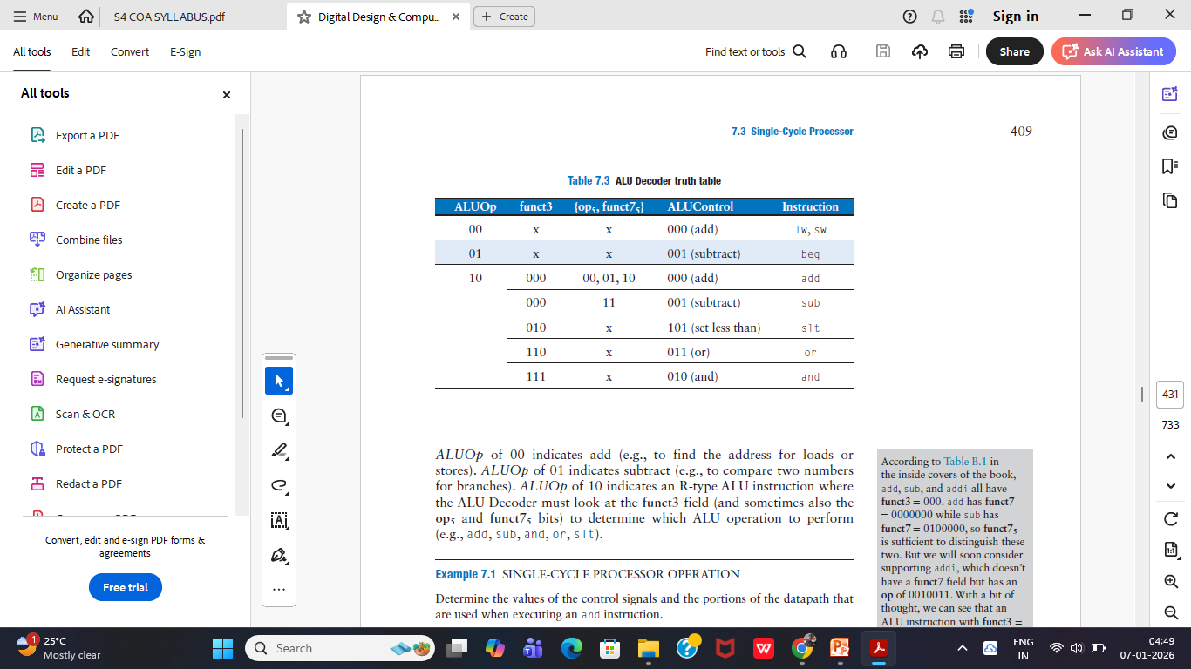
The ALU Decoder produces ALUControl based on ALUOp and funct3.
In the case of the sub and add instructions, the ALU Decoder also uses funct75 and op5 to determine ALUControl as given in in Table 7.3.

Slide 63
ALUOp of 00 indicates add (e.g., to find the address for loads or stores).
ALUOp of 01 indicates subtract (e.g., to compare two numbers for branches).
ALUOp of 10 indicates an R-type ALU instruction where the ALU Decoder must look at the funct3 field (and sometimes also the op5 and funct75 bits) to determine which ALU operation to perform (e.g., add, sub, and, or, slt).

Slide 64
Q. Determine the values of the control signals and the portions of the datapath that are used when executing an and instruction.
Solution Figure 7.14 illustrates the control signals and flow of data during execution of an and instruction.
The PC points to the memory location holding the instruction; the instruction memory outputs this instruction.
The main flow of data through the register file and ALU is represented with a heavy blue line.
The register file reads the two source operands specified by Instr.
SrcB should come from the second port of the register file (not ImmExt), so ALUSrc must be 0.
The ALU performs a bitwise AND operation, so ALUControl must be 010.

Slide 65
The result comes from the ALU, so ResultSrc is 0, and the result is written to the register file, so RegWrite is 1.
The instruction does not write memory, so MemWrite is 0.
The updating of PC with PCPlus4 is shown by a heavy gray line.
PCSrc is 0 to select the incremented PC.
Note that data does flow through the nonhighlighted paths, but the value of that data is disregarded.
For example, the immediate is extended and a value is read from memory, but these values do not influence the next state of the system.

Slide 66
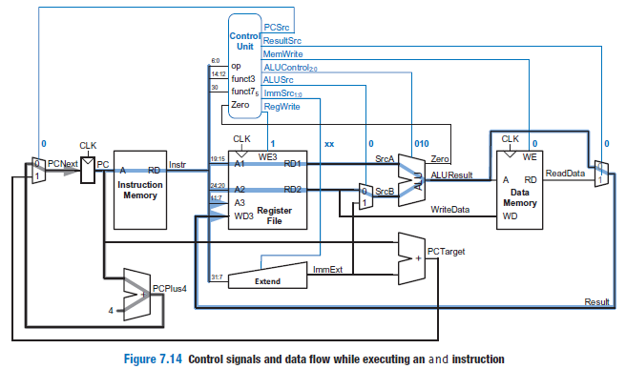

Slide 67
Pipelined Processor -
Pipelined Data Path,

Slide 68
PIPELINED PROCESSOR: 461
Pipelining is a powerful way to improve the throughput of a digital system.
We design a pipelined processor by subdividing the single-cycle processor into five pipeline stages.
Thus, five instructions can execute simultaneously, one in each stage.
Because each stage has only one-fifth of the entire logic, the clock frequency is approximately five times faster.
So, ideally, the latency of each instruction is unchanged, but the throughput is five times better.
Microprocessors execute millions or billions of instructions per second, so throughput is more important than latency.

Slide 69
Reading and writing the memory and register file and using the ALU typically constitute the biggest delays in the processor.
We choose five pipeline stages so that each stage involves exactly one of these slow steps.
Specifically, we call the five stages Fetch, Decode, Execute, Memory, and Writeback.
They are similar to the five steps that the multicycle processor used to perform lw.

Slide 70
In the Fetch stage, the processor reads the instruction from instruction memory.
In the Decode stage, the processor reads the source operands from the register file and decodes the instruction to produce the control signals.
In the Execute stage, the processor performs a computation with the ALU.
In the Memory stage, the processor reads or writes data memory, if applicable.
Finally, in the Writeback stage, the processor writes the result to the register file, if applicable.

Slide 71
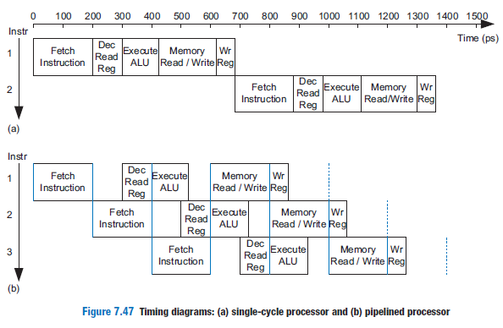
Figure 7.47 shows a timing diagram comparing the single-cycle and pipelined processors. Time is on the horizontal axis and instructions are on the vertical axis.

Slide 72
In the single-cycle processor in Figure 7.47(a), the first instruction is read from memory at time 0.
Next, the operands are read from the register file.
Then, the ALU executes the necessary computation.
Finally, the data memory may be accessed, and the result is written back to the register file at 680 ps.(pico second)
The second instruction begins when the first completes.
Hence, in this diagram, the single-cycle processor has an instruction latency of 200 + 100 + 120 + 200 + 60 = 680 ps (see Table 7.7 on page 415) and a throughput of 1 instruction per 680 ps (1.47 billion instructions per second).

Slide 73
In the pipelined processor in Figure 7.47(b), the length of a pipeline stage is set at 200 ps by the slowest stage, the memory access in the Fetch or Memory stage.
Each pipeline stage is indicated by solid or dashed vertical blue lines.
At time 0, the first instruction is fetched from memory.
At 200 ps, the first instruction enters the Decode stage, and a second instruction is fetched.
At 400 ps, the first instruction executes, the second instruction enters the Decode stage, and a third instruction is fetched.
And so forth, until all the instructions complete.

Slide 74
The instruction latency is 5 × 200 = 1000 ps.
Because the stages are not perfectly balanced with equal amounts of logic, the latency is longer for the pipelined processor than for the single-cycle processor.
The throughput is 1 instruction per 200 ps (5 billion instructions per second)—that is, one instruction completes every clock cycle.
This throughput is 3.4 times as much as the single-cycle processor

Slide 75
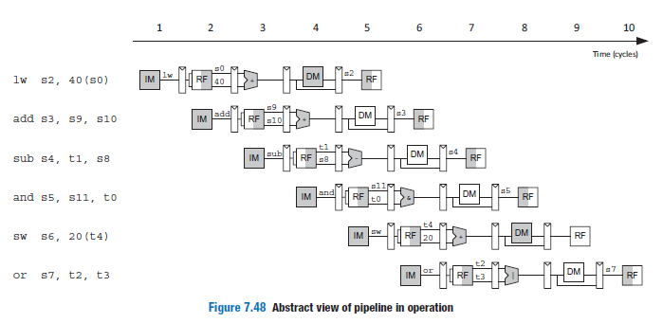

Slide 76
Figure 7.48 shows an abstracted view of the pipeline in operation in which each stage is represented pictorially.
Each pipeline stage is represented with its major component—instruction memory (IM), register file (RF) read, ALU execution, data memory (DM), and register file writeback—to illustrate the flow of instructions through the pipeline.
Reading across a row shows the clock cycle in which a particular instruction is in each stage.

Slide 77
For example, the sub instruction is fetched in cycle 3 and executed in cycle 5.
Reading down a column shows what the various pipeline stages are doing on a particular cycle.
For example, in cycle 6, the register file is writing a sum to s3, the data memory is idle, the ALU is computing (s11 & t0), t4 is being read from the register file, and the or instruction is being fetched from instruction memory.
Stages are shaded to indicate when they are used.
For example, the data memory is used by lw in cycle 4 and by sw in cycle 8.
The instruction memory and ALU are used in every cycle.

Slide 78
The register file is written by every instruction except sw.
In the pipelined processor, the register file is used twice in every cycle: it is written in the first part of a cycle and read in the second part, as suggested by the shading.
This way, data can be written by one instruction and read by another within a single cycle.

Slide 79
A central challenge in pipelined systems is handling hazards that occur when one instruction’s result is needed by a subsequent instruction before the former instruction has completed.
For example, if the add in Figure 7.48 used s2 as a source instead of s10, a hazard would occur because the s2 register has not yet been written by the lw instruction when it is read by add in cycle 3.

Slide 80
Pipelined Datapath: 463
The pipelined datapath is formed by chopping the single-cycle datapath into five stages separated by pipeline registers.
Figure 7.49(a) shows the single-cycle datapath stretched out to leave room for the pipeline registers.
Figure 7.49(b) shows the pipelined datapath formed by inserting four pipeline registers to separate the datapath into five stages.
The stages and their boundaries are indicated in blue.
Signals are given a suffix (F, D, E, M, or W) to indicate the stage in which they reside.

Slide 81
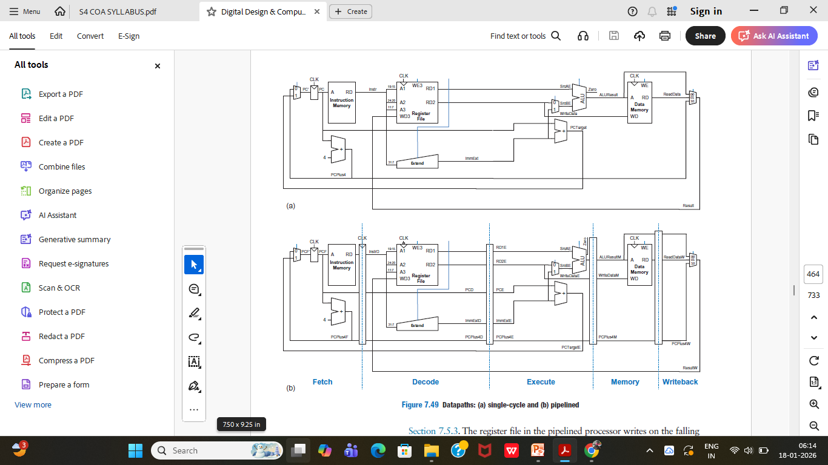

Slide 83
The register file is read in the Decode stage and written in the Writeback stage.
So, although the register file is drawn in the Decode stage, its write address and write data come from the Writeback stage.
This feedback will lead to pipeline hazards.
The register file in the pipelined processor writes on the falling edge of CLK so that it can write a result in the first half of a cycle and read that result in the second half of the cycle for use in a subsequent instruction.

Slide 84
One of the subtle but critical issues in pipelining is that all signals associated with a particular instruction must advance through the pipeline in unison.
The error is in the register file write logic, which should operate in the Writeback stage.
The data value comes from ResultW, a Writeback stage signal.
But the destination register comes from RdD (InstrD11:7), which is a Decode stage signal.
In the pipeline diagram of Figure 7.48, during cycle 5, the result of the lw instruction would be incorrectly written to s5 rather than s2.

Slide 85
Figure 7.50 shows a corrected datapath, with the modification in blue.
The Rd signal is now pipelined along through the Execution, Memory, and Writeback stages, so it remains in sync with the rest of the instruction.
RdW and ResultW are fed back together to the register file in the Writeback stage.
The logic to produce PCF’ (the next PC) is also problematic because it could be updated with either a Fetch or an Execute stage signal (PCPlus4F or PCTargetE).

Slide 86
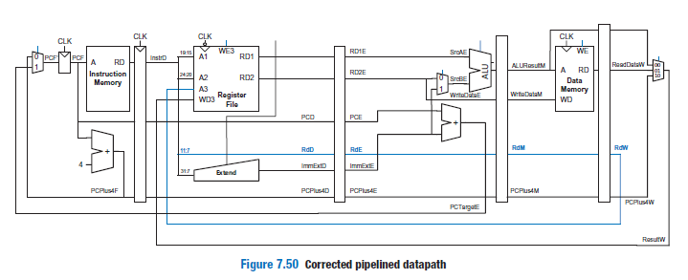

Slide 87
Pipelined Control:
Hazards,
Solving Data/Control Hazards,
Performance Analysis.

Slide 88
Pipelined Control: 465
The pipelined processor uses the same control signals as the single-cycle processor and, therefore, has the same control unit.
The control unit examines the op, funct3, and funct75 fields of the instruction in the Decode stage to produce the control signals.
These control signals must be pipelined along with the data so that they remain synchronized with the instruction.

Slide 89
Pipelined Control: 465
The entire pipelined processor with control is shown in Figure 7.51.
RegWrite must be pipelined into the Writeback stage before it feeds back to the register file, just as Rd was pipelined in Figure 7.50.
In addition to R-type ALU instructions, lw, sw, and beq, this pipelined processor also supports jal and I-type ALU instructions.

Slide 90
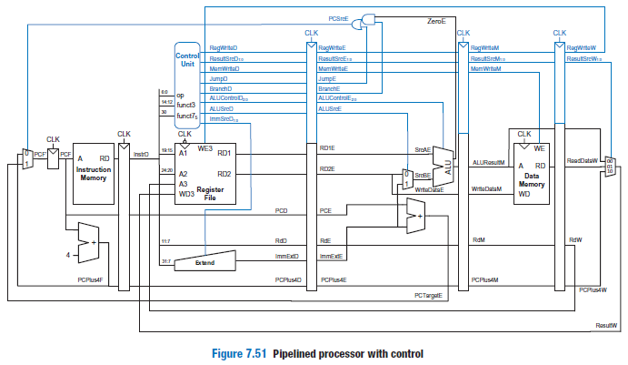

Slide 91
HAZARDS: 465
In a pipelined system, multiple instructions are handled concurrently.
When one instruction is dependent on the results of another that has not yet completed, a hazard occurs.
The register file is written during the first half of the cycle and read during the second half of the cycle, so a register can be written and read back in the same cycle without introducing a hazard.

Slide 92
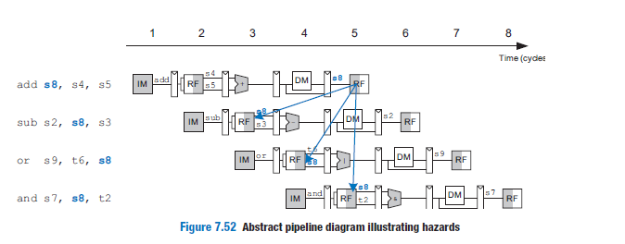

Slide 93
HAZARDS: 465
Figure 7.52 illustrates hazards that occur when one instruction writes a register (s8) and subsequent instructions read this register.
The blue arrows highlight when s8 is written to the register file (in cycle 5) as compared to when it is needed by subsequent Instructions.
This is called a read after write (RAW) hazard.

Slide 94
The add instruction writes a result into s8 in the first half of cycle 5.
However, the sub instruction reads s8 on cycle 3, obtaining the wrong value.
The or instruction reads s8 on cycle 4, again obtaining the wrong value.
The and instruction reads s8 in the second half of cycle 5, obtaining the correct value, which was written in the first half of cycle 5.
Subsequent instructions also read the correct value of s8.
The diagram shows that hazards may occur in this pipeline when an instruction writes a register and either of the two subsequent instructions reads that register.

Slide 95
A software solution would be to require the programmer or compiler to insert nop instructions between the add and sub instructions so that the dependent instruction does not read the result (s8) until it is available in the register file, as shown in Figure 7.53.
Such a software interlock complicates programming and degrades performance, so it is not ideal.

Slide 96
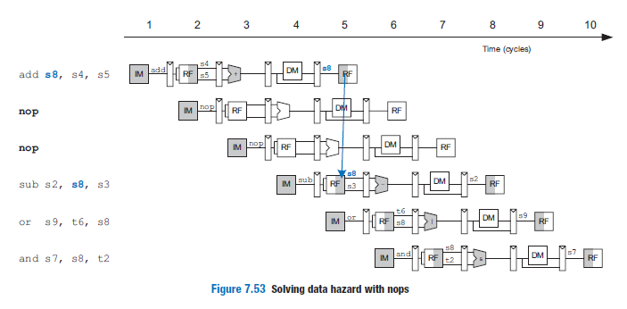

Slide 97
Hazards are classified as data hazards or control hazards.
A data hazard occurs when an instruction tries to read a register that has not yet been written back by a previous instruction.
A control hazard occurs when the decision of what instruction to fetch next has not been made by the time the fetch takes place.

Slide 98
Solving Data Hazards with Forwarding: 468
Some data hazards can be solved by forwarding (also called bypassing) a result from the Memory or Writeback stage to a dependent instruction in the Execute stage.
This requires adding multiplexers in front of the ALU to select its operands from the register file or the Memory or Writeback stage.
Figure 7.54 illustrates this principle.

Slide 99
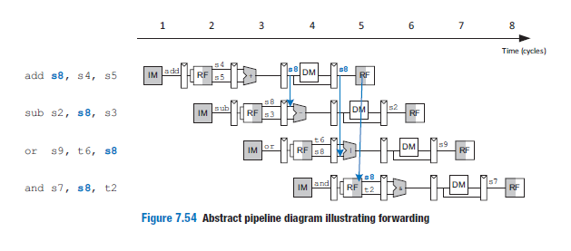

Slide 100
This program computes s8 with the add instruction and then uses s8 in the three subsequent instructions.
In cycle 4, s8 is forwarded from the Memory stage of the add instruction to the Execute stage of the dependent sub instruction.
In cycle 5, s8 is forwarded from the Writeback stage of the add instruction to the Execute stage of the dependent or instruction.
Again, no forwarding is needed for the and instruction because s8 is written to the register file in the first half of cycle 5 and read in the second half.

Slide 101
Forwarding is necessary when an instruction in the Execute stage has a source register matching the destination register of an instruction in the Memory or Writeback stage.
Figure 7.55 modifies the pipelined processor to support forwarding.
It adds a Hazard Unit and two forwarding multiplexers.
The hazard detection unit receives the two source registers from the instruction in the Execute stage, Rs1E and Rs2E, and the destination registers from the instructions in the Memory and Writeback stages, RdM and RdW.

Slide 102
It also receives the RegWrite signals from the Memory and Writeback stages (RegWriteM and RegWriteW) to know whether the destination register will actually be written (e.g., the sw and beq instructions do not write results to the register file and, hence, do not have their results forwarded).

Slide 103
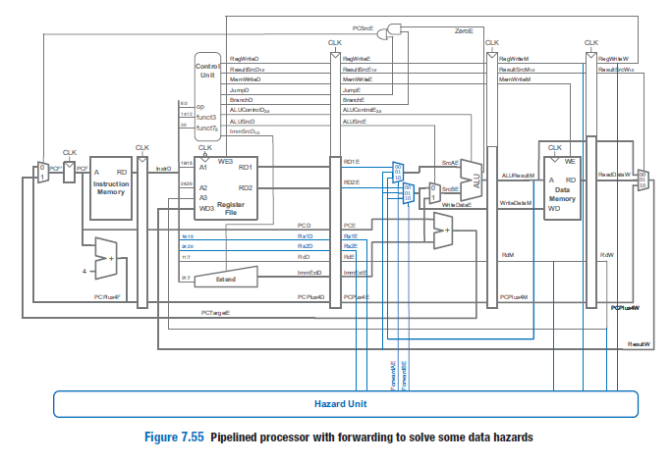

Slide 104
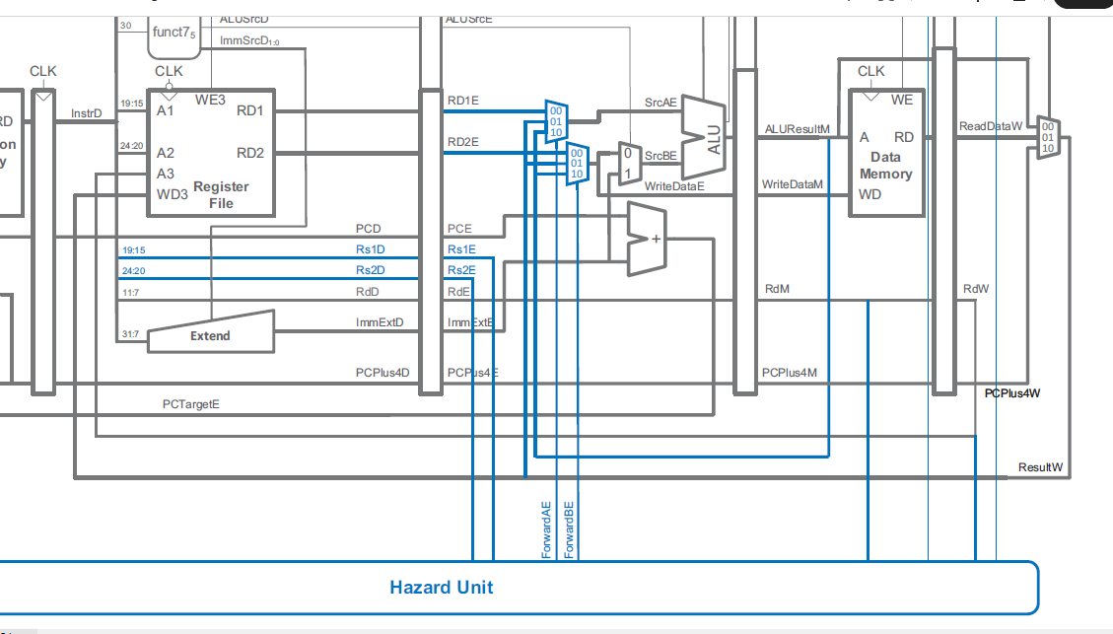

Slide 105
The Hazard Unit computes control signals for the forwarding multiplexers to choose operands from the register file or from the results in the Memory or Writeback stage (ALUResultM or ResultW).
The Hazard Unit should forward from a stage if that stage will write a destination register and the destination register matches the source register.
However, x0 is hardwired to 0 and should never be forwarded.
If both the Memory and Writeback stages contain matching destination registers, then the Memory stage should have priority because it contains the more recently executed instruction.

Slide 106
The forwarding logic for SrcBE (ForwardBE) is identical except that it
checks Rs2E instead of Rs1E.
if ((Rs1E == RdM) & RegWriteM) & (Rs1E != 0) then ForwardAE = 10
// Forward from Memory stage
else if ((Rs1E == RdW) & RegWriteW) & (Rs1E != 0) then ForwardAE = 01
// Forward from Writeback stage
else ForwardAE = 00 // No forwarding (use RF output)

Slide 107
Solving Data Hazards with stalls: 470
Forwarding is sufficient to solve RAW data hazards when the result is computed in the Execute stage of an instruction because its result can then be forwarded to the Execute stage of the next instruction.
Unfortunately, the lw instruction does not finish reading data until the end of the Memory stage, so its result cannot be forwarded to the Execute stage of the next instruction.
We say that the lw instruction has a two-cycle latency because a dependent instruction cannot use its result until two cycles later.
Figure 7.56 shows this problem.

Slide 108
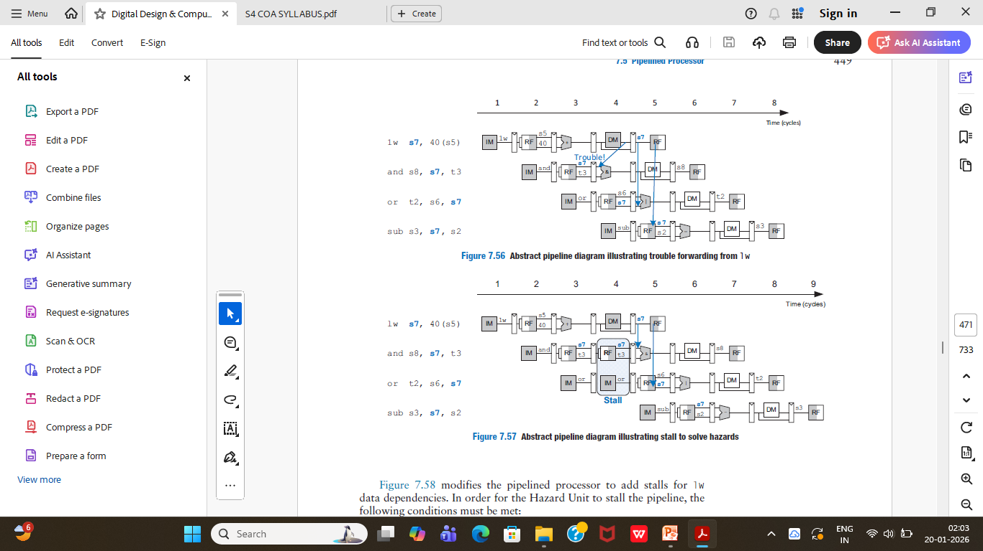

Slide 109
The lw instruction receives data from memory at the end of cycle 4, but the and instruction needs that data (the value in s7) as a source operand at the beginning of cycle 4.
There is no way to solve this hazard with forwarding.
A solution is to stall the pipeline, holding up operation until the data is available.
Figure 7.57 shows stalling the dependent instruction (and) in the Decode stage. and enters the Decode stage in cycle 3 and stalls there through cycle 4.
The subsequent instruction (or) must remain in the Fetch stage during both cycles as well because the Decode stage is full.

Slide 111
In cycle 5, the result can be forwarded from the Writeback stage of lw to the Execute stage of and.
Also, in cycle 5, source s7 of the or instruction is read directly from the register file, with no need for forwarding.

Slide 112
The Execute stage is unused in cycle 4.
Likewise, Memory is unused in cycle 5 and Writeback is unused in cycle 6.
This unused stage propagating through the pipeline is called a bubble, which behaves like a nop instruction.
The bubble is introduced by zeroing out the Execute stage control signals during a Decode stage stall so that the bubble performs no action and changes no architectural state.

Slide 113
stalling a stage is performed by disabling its pipeline register (i.e., the register to the left of a stage) so that the stage’s inputs do not change.
When a stage is stalled, all previous stages must also be stalled so that no subsequent instructions are lost.
The pipeline register directly after the stalled stage must be cleared (flushed) to prevent bogus information from propagating forward.
Stalls degrade performance, so they should be used only when necessary.

Slide 114
Figure 7.58 modifies the pipelined processor to add stalls for lw data dependencies.
In order for the Hazard Unit to stall the pipeline, the following conditions must be met:
1. A load word is in the Execute stage (indicated by ResultSrcE0 = 1)
and
2. The load’s destination register (RdE) matches Rs1D or Rs2D, the source operands of the instruction in the Decode stage

Slide 115
Stalls are supported by adding enable inputs (EN) to the Fetch and Decode pipeline registers and a synchronous reset/clear (CLR) input to the Execute pipeline register.
When a load word (lw) stall occurs, StallD and StallF are asserted to force the Decode and Fetch stage pipeline registers to retain their existing values.
FlushE is also asserted to clear the contents of the Execute stage pipeline register, introducing a bubble.
The Hazard Unit lwStall (load word stall) signal indicates when the pipeline should be stalled due to a load word dependency.

Slide 116
Whenever lwStall is
TRUE, all of the stall and flush signals are asserted. Hence, the logic to
compute the stalls and flushes is:
lwStall = ResultSrcE0 & ((Rs1D = = RdE) | (Rs2D = = RdE))
StallF = StallD = FlushE = lwStall

Slide 117
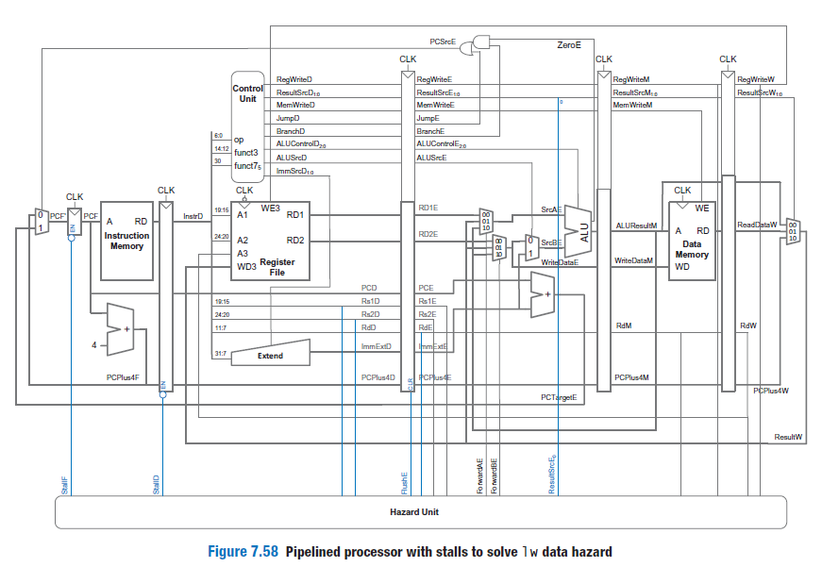

Slide 118
Solving Control Hazards: 472
The beq instruction presents a control hazard: the pipelined processor does not know what instruction to fetch next because the branch decision has not been made by the time the next instruction is fetched.
One mechanism for dealing with this control hazard is to stall the pipeline until the branch decision is made (i.e., PCSrcE is computed).

Slide 119
Because the decision is made in the Execute stage, the pipeline would have to be stalled for two cycles at every branch.
This would severely degrade the system performance if branches occur often, which is typically the case.
An alternative to stalling the pipeline is to predict whether the branch will be taken and begin executing instructions based on the prediction.
Once the branch decision is available, the processor can throw out the instructions if the prediction was wrong.

Slide 120
In the pipeline presented before(Figure 7.58), the processor predicts that branches are not taken and simply continues executing the program in order until PCSrcE is asserted to select the next PC from PCTargetE instead.
If the branch should have been taken, then the two instructions following the branch must be flushed (discarded) by clearing the pipeline registers for those instructions.
These wasted instruction cycles are called the branch misprediction penalty.

Slide 121
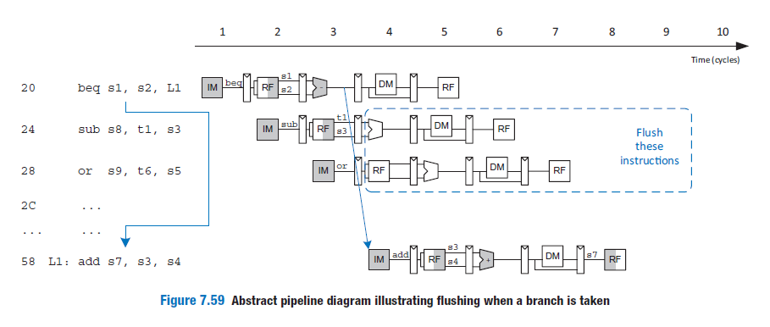

Slide 122
Figure 7.59 shows such a scheme in which a branch from address 0x20 to address 0x58 is taken.
The PC is not written until cycle 3, by which point the sub and or instructions at addresses 0x24 and 0x28 have already been fetched.
These instructions must be flushed, and the add instruction is fetched from address 0x58 in cycle 4.

Slide 123
we add a synchronous clear input (CLR) to the Decode pipeline register and add the FlushD output to the Hazard Unit. (When CLR = 1, the register contents are cleared, that is, become 0.)
When a branch is taken (indicated by PCSrcE being 1), FlushD and FlushE must be asserted to flush the Decode and Execute pipeline registers.
Figure 7.60 shows the enhanced pipelined processor for handling control hazards.
The flushes are now calculated as:
    FlushD = PCSrcE
    FlushE = lwStall | PCSrcE

Slide 124
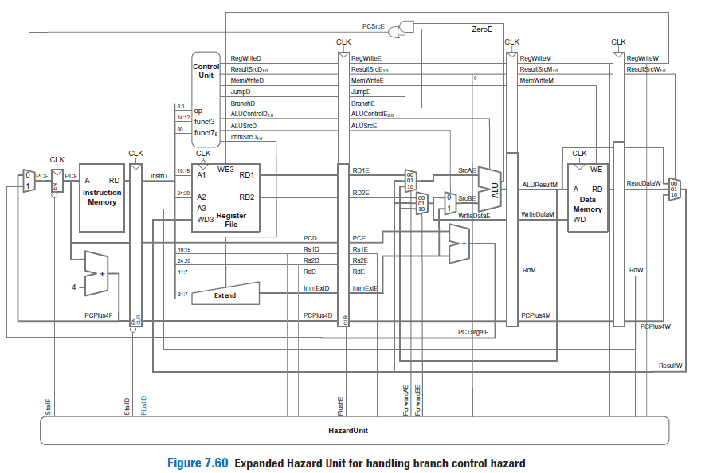

Slide 125
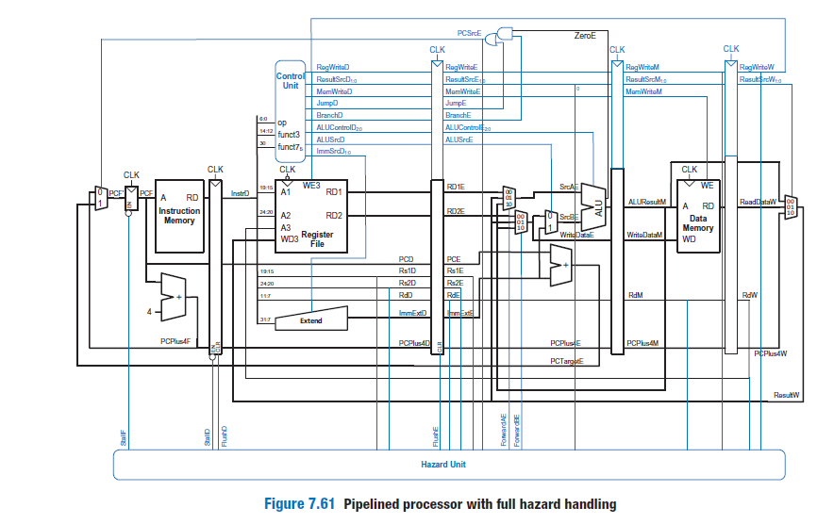

Slide 126
Performance Analysis: 475
The pipelined processor ideally would have a CPI(clock per instruction) of 1 because a new instruction is issued—that is, fetched—every cycle.
However, a stall or a flush wastes 1 to 2 cycles, so the CPI is slightly higher and depends on the specific program being executed.
We can determine the cycle time by considering the critical path in each of the five pipeline stages shown in Figure 7.61.
Recall that the register file is used twice in a single cycle: it is written in the first half of the Writeback cycle and read in the second half of the Decode cycle; so these stages can use only half of the cycle time for their critical path.

Slide 127
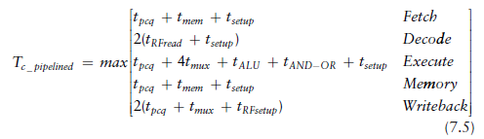
Figure 7.62 shows the critical path for the Execute stage.
It occurs when a branch is in the Execute stage that requires forwarding from the Writeback stage: the path goes from the Writeback pipeline register, through the Result, ForwardBE, and SrcB multiplexers, through the ALU and AND-OR logic to the PC multiplexer and, finally, to the PC register.

Slide 128
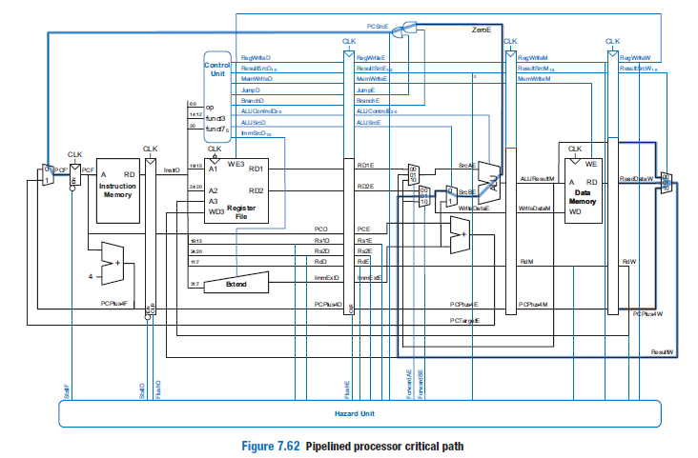
Page: 477

Slide 129
The pipelined processor is substantially faster than the others.
However, its advantage over the single-cycle processor is nowhere near the fivefold speedup one might hope to get from a five-stage pipeline.
The pipeline hazards introduce a small CPI penalty.
The pipelined processor is similar in hardware requirements to the single-cycle processor, but it adds many 32-bit pipeline registers, along with multiplexers, smaller pipeline registers, and control logic to resolve hazards.

Slide 130
END

